Slide 1
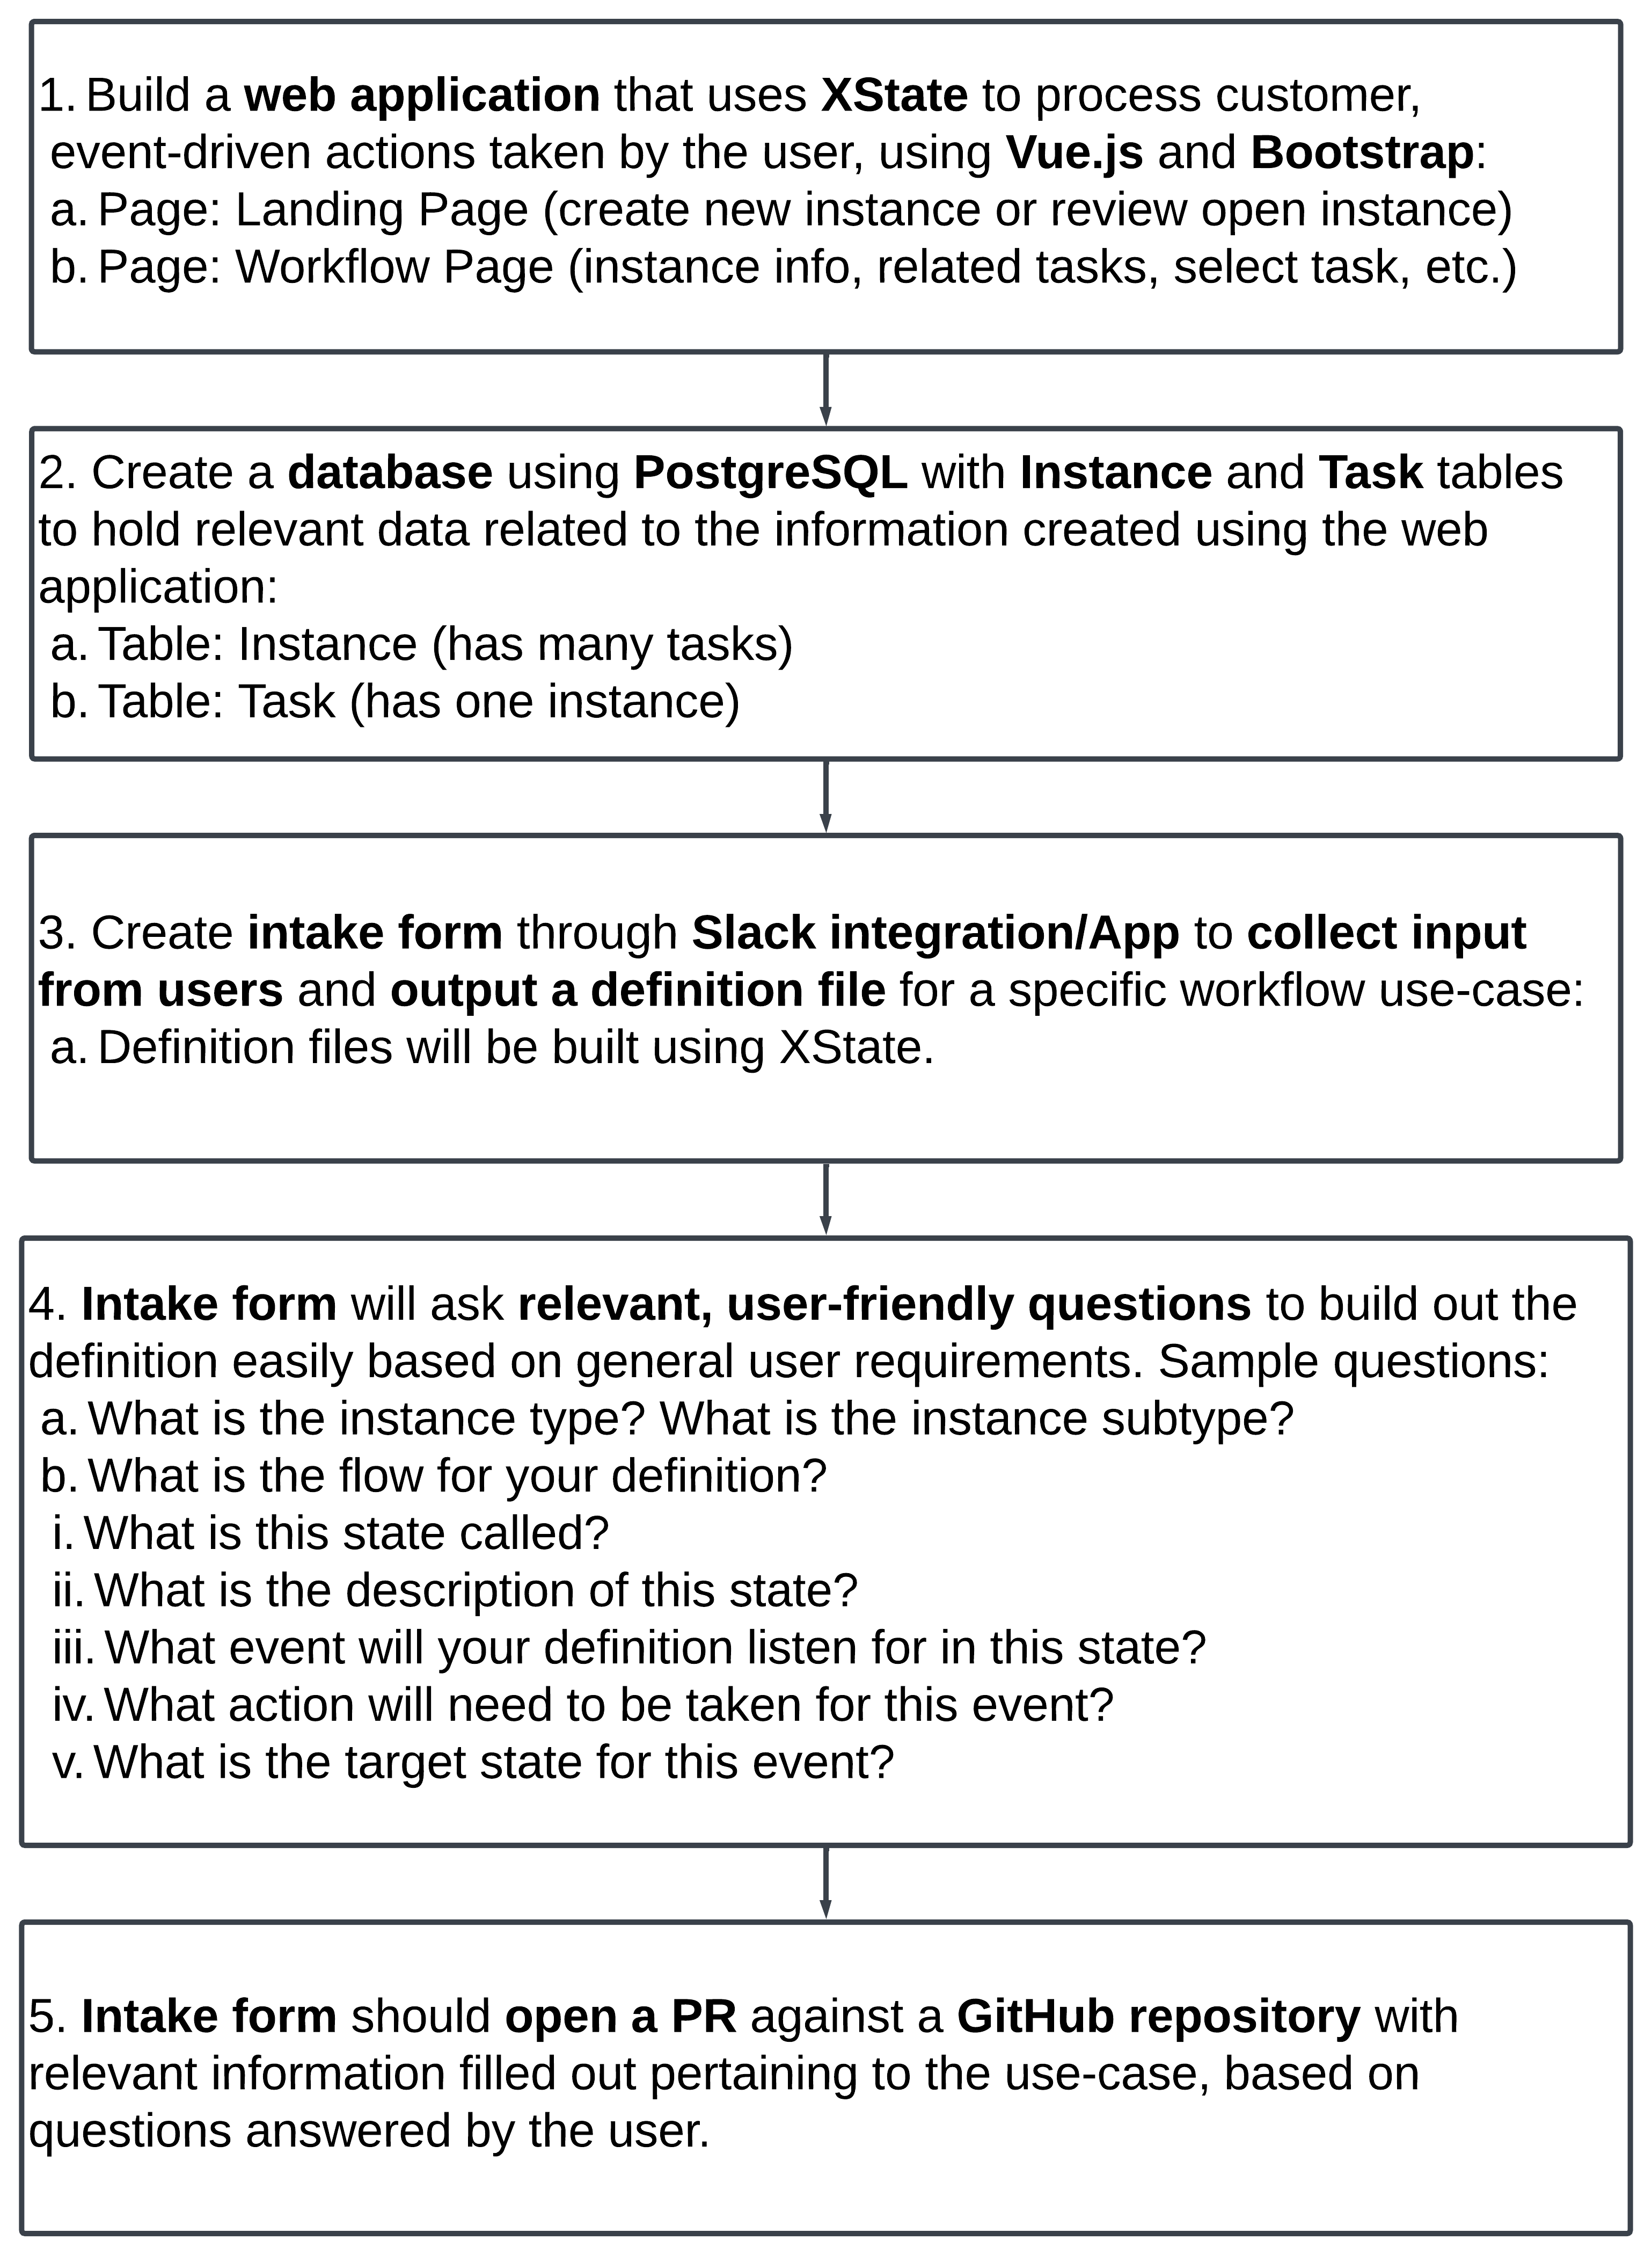
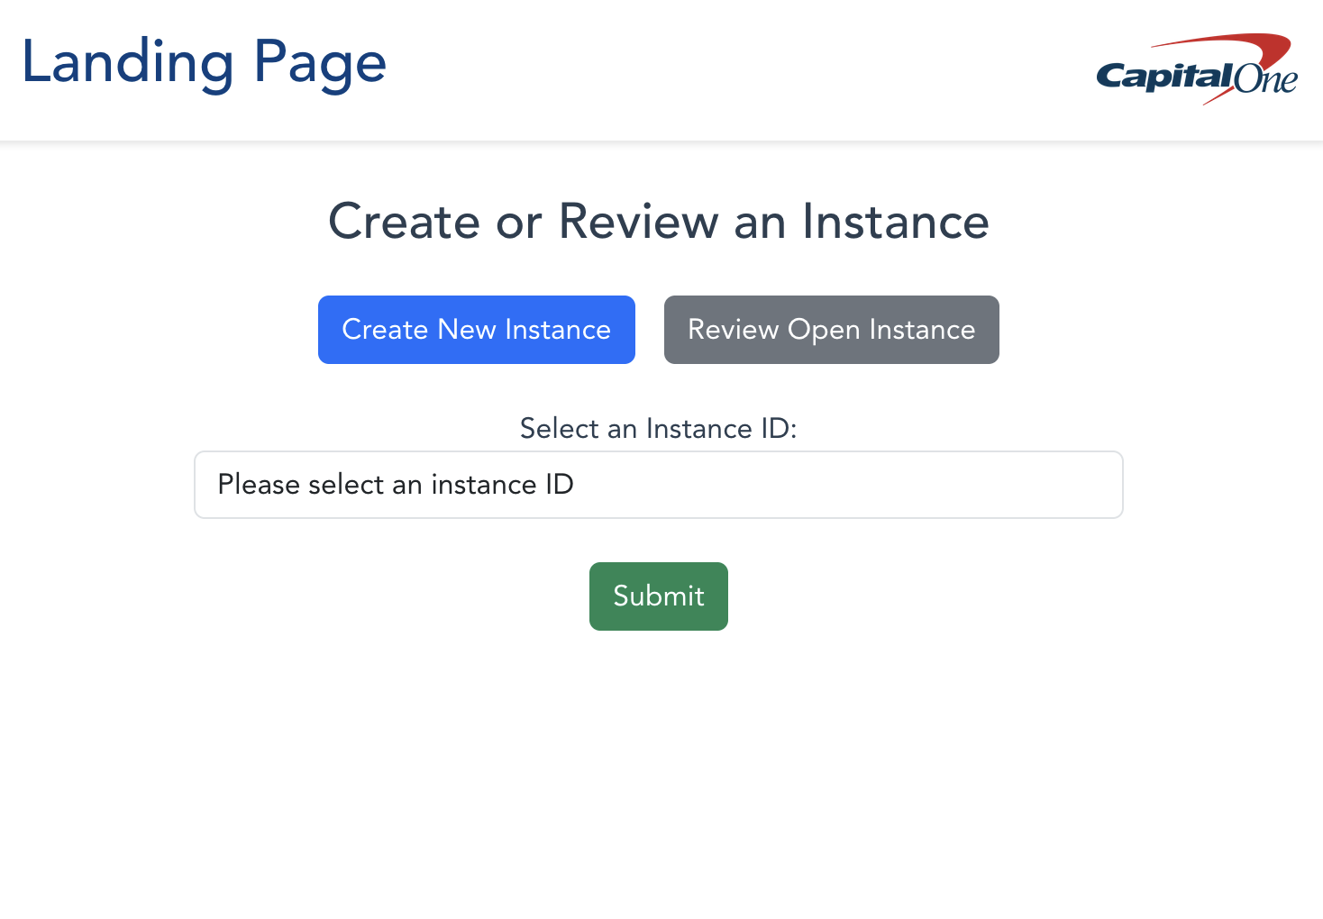
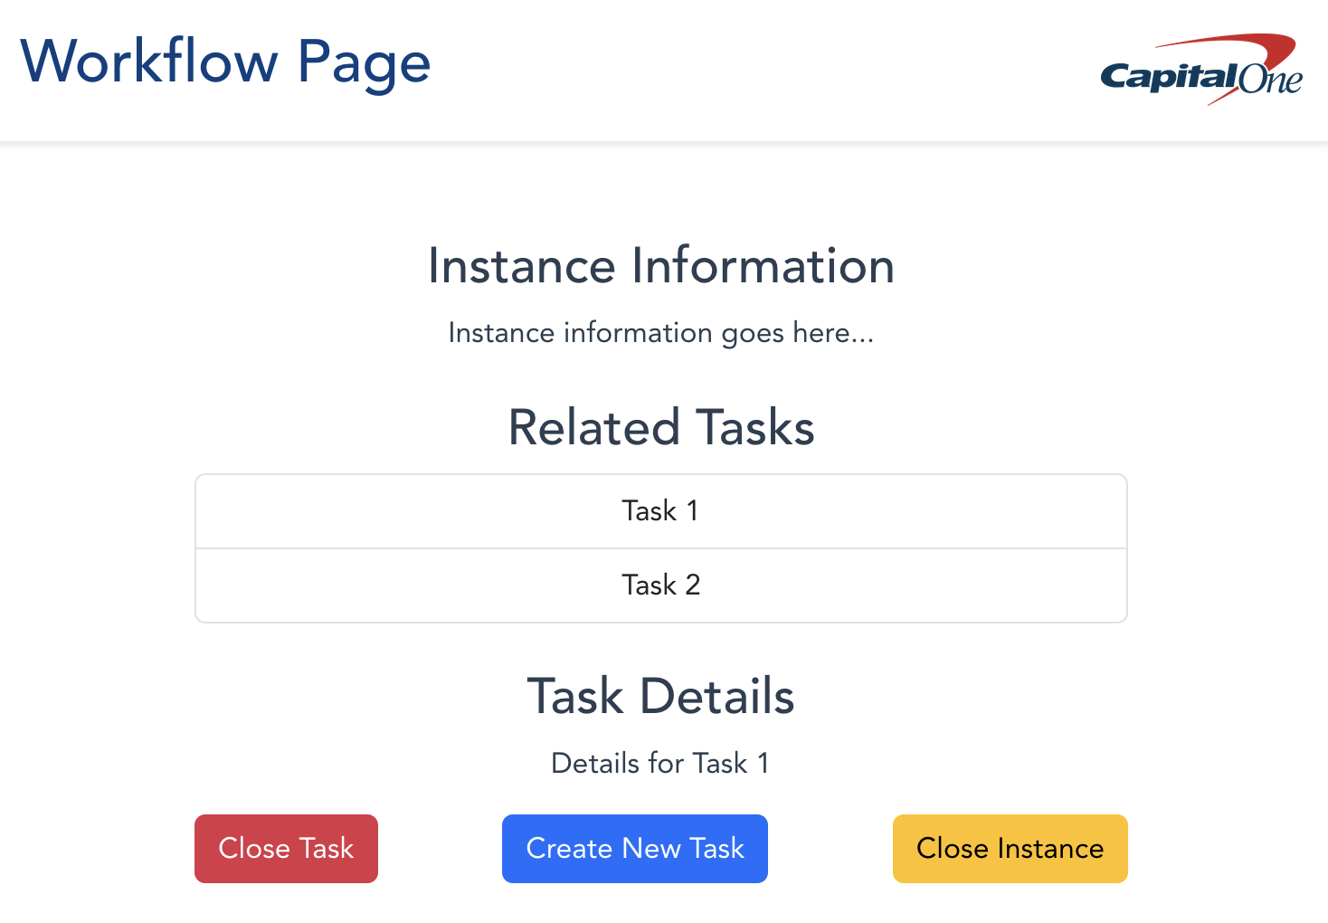






25-327
XState Builder
Team members: Sohum Dharamsi, Neil Randeri, Bryan Wheeler, Peter Dang | Faculty adviser: Irfan Ahmed, Ph.D. | Sponsor: Capital One | Mentor: Jacquelyn Dellinger
Problem
As a platform stakeholder, there is an increased need for workflow organization and management. However, there is currently no direct management or application for users to complete these requirements. This project aims to quickly and efficiently build a workflow description of our users’ event-driven workflow process based on their requirements using XState. This application must be user friendly and be able to take in information from these users.
Approach
Currently Completed/Working On
Simple Docker container has been created for our web application using vue.js.
Landing page and Workflow page, both with buttons and dropdown menus.
Currently using vue.js and bootstrap libraries to implement an aesthetic and appealing user interface.
What is XState?
XState is a state management and orchestration solution for JavaScript and TypeScript apps.
It uses event-driven programming, state machines, state charts, and the actor model to handle complex logic in predictable, robust, and visual ways.
It provides a powerful and flexible way to manage application and workflow state by allowing developers to model logic as actors and state machines.
Objective
Develop an interactive and intuitive web application, backed by a database, utilizing XState to streamline the creation and management of event-driven workflow processes based on user-defined requirements. This application will display available XState definitions for users to select and allow them to trigger specific events for each definition. It will also enable functionalities like creating new instances, reviewing open instances, and managing task-based workflows. An intake form will guide users through creating customized workflow definition files by asking targeted questions. The form’s responses will then be automatically committed to a GitHub repository. Our application will foster learning in areas such as XState, event-driven programming, front-end development, database management, and enterprise integration, ultimately enabling users to build and refine workflows with ease.
Future Steps
Create Instance and Task tables and connect the database to the web application.
Create the intake form and format it with relevant, user-friendly questions.
Work on PR implementation once an intake form is submitted.
Keep working on weekly status reports in GitHub.
References
1. XState | Stately. Stately.ai. Published 2024. Accessed November 5, 2024. https://stately.ai/docs/xstate

